Slide 1
Results
As the solubility product of Mg(OH)₂ is too small (1.0×10⁻¹¹). Even if we reduce the concentration in salt solution till 0.1 ppm, there is still scaling on membrane surface
→ In that case, we want to try the minimum concentration of Ca first.
When the concentration of Mg was above 20 ppm, there is scaling on SCEM facing salt. chamber and the opposite surface is clean
e.g. Page 2
When the concentration of Mg was below 20 ppm, there is no visible scaling on SCEM facing salt chamber and scaling can be observed on the membrane surface facing base chamber.
e.g. Page 3-6

Slide 2
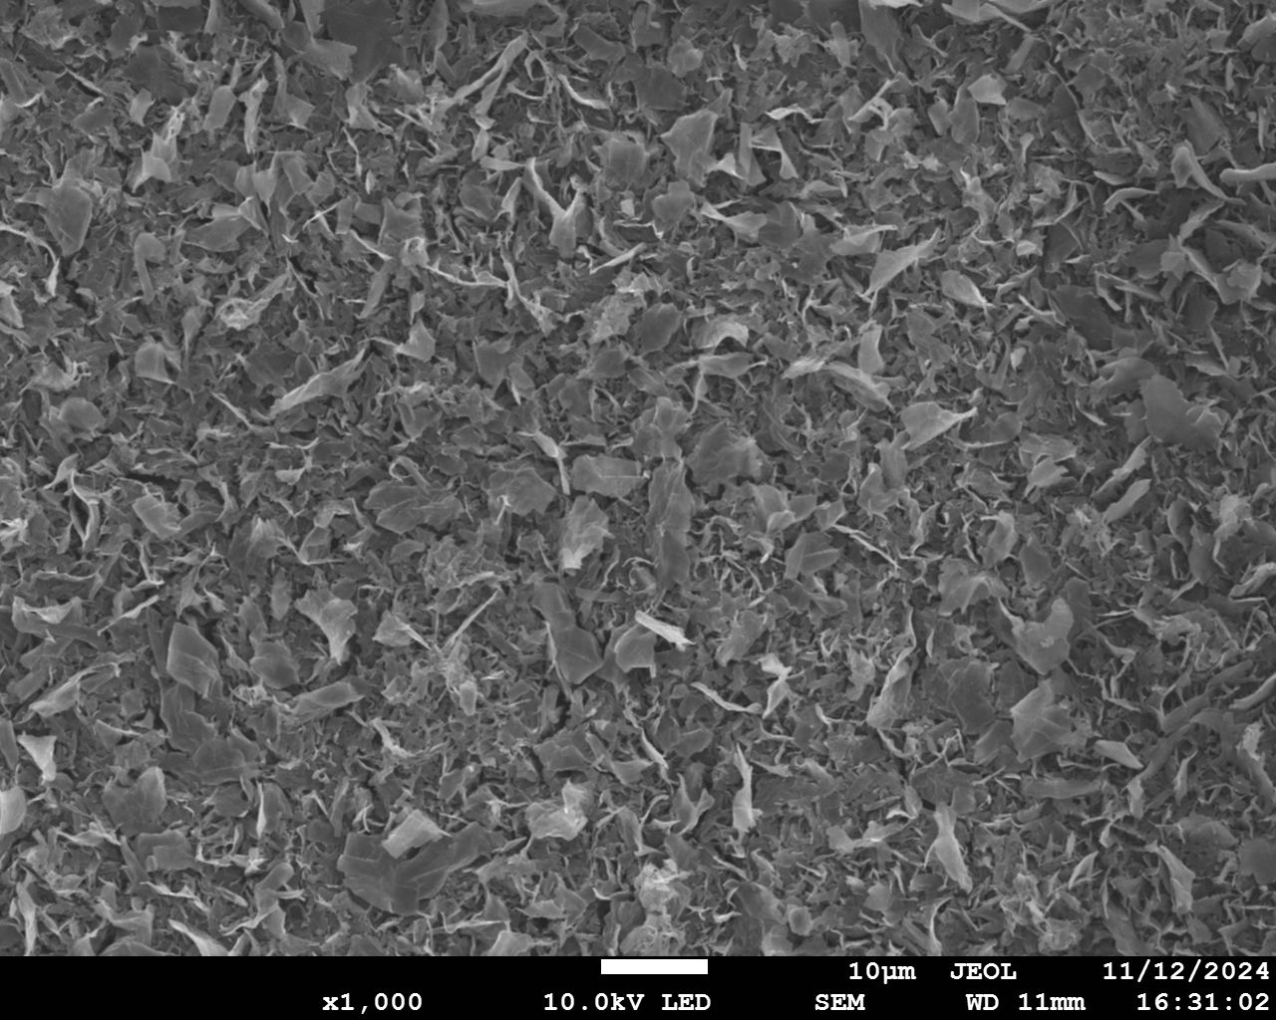
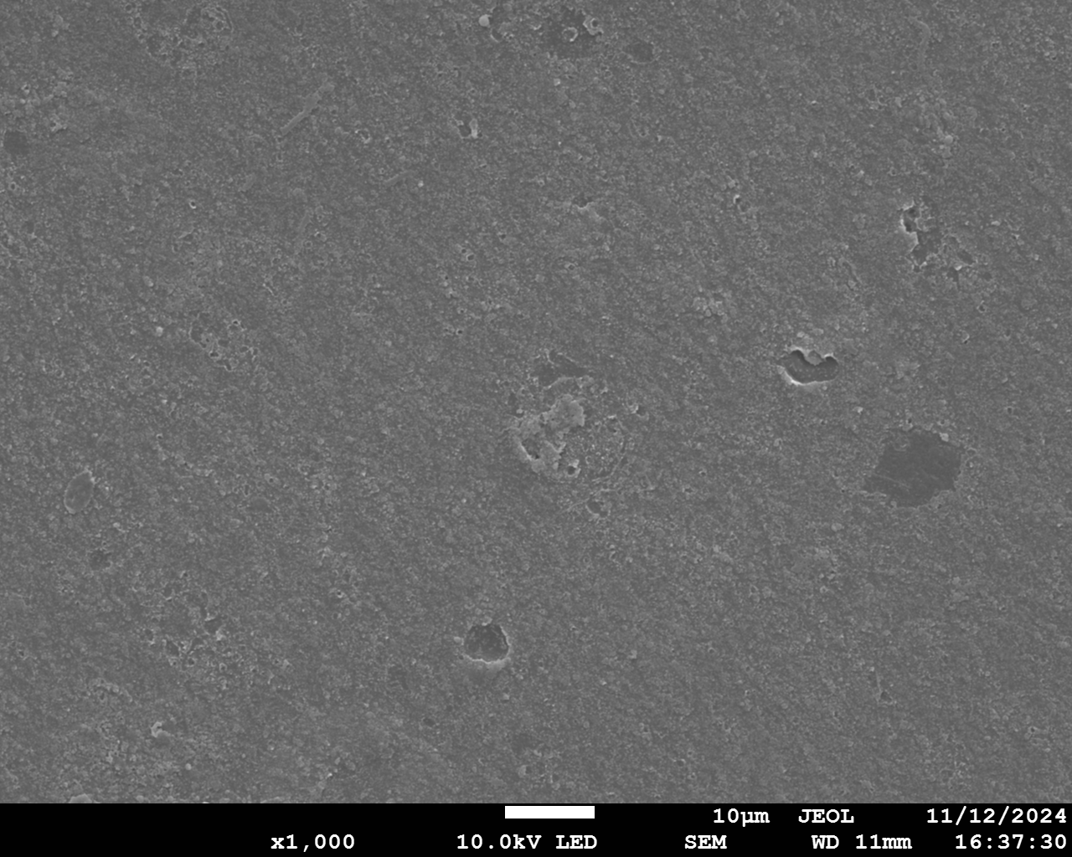
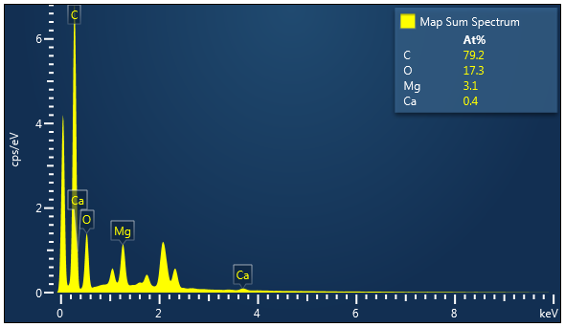
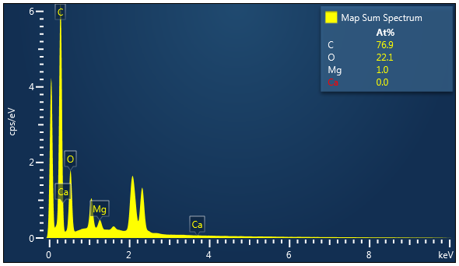
50 ppm Mg 0 ppm Ca
Scaling
FSWB
FB
10 μm
10 μm

Slide 3
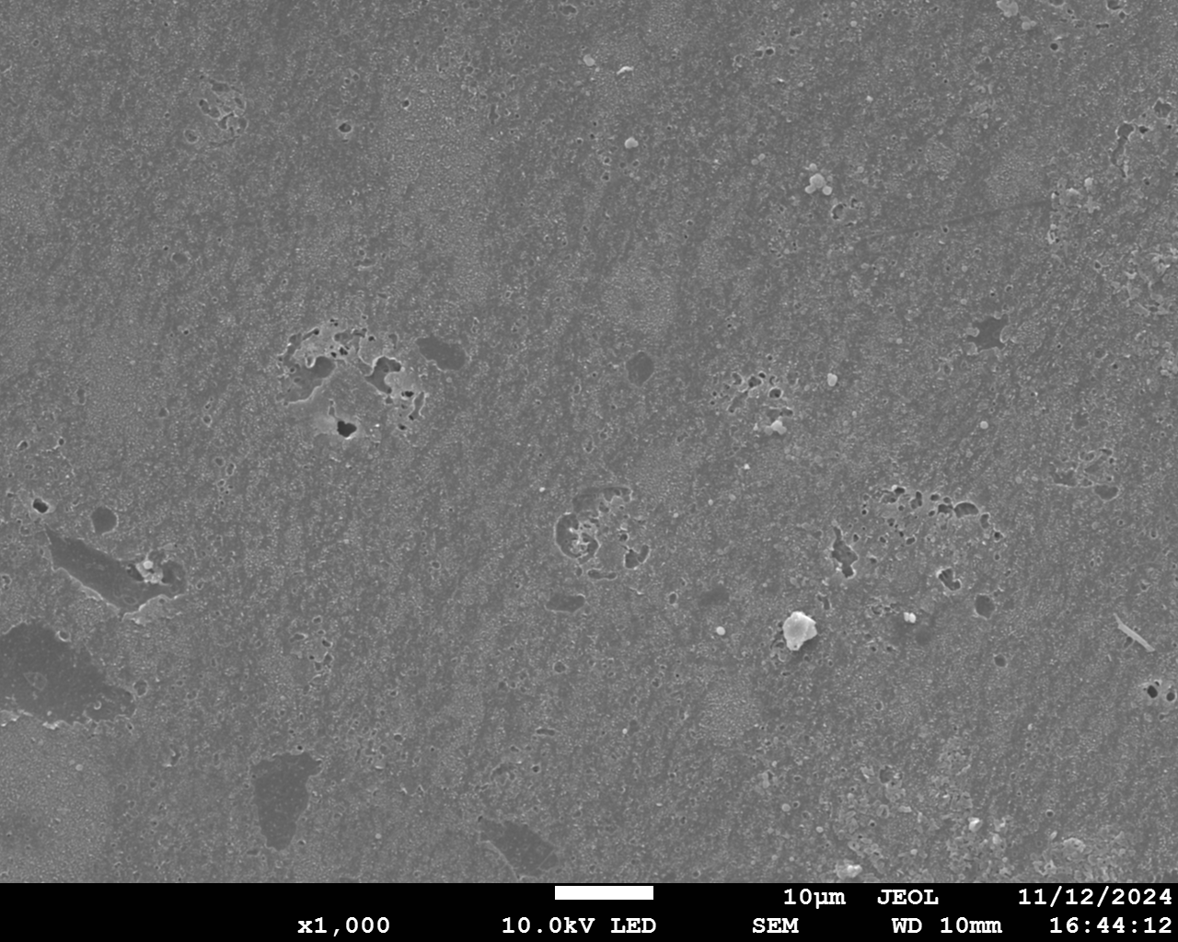
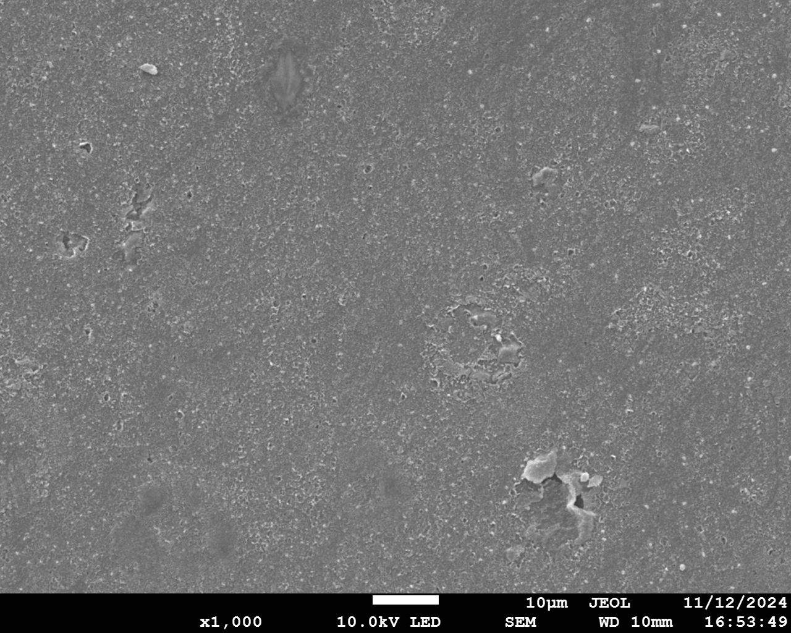
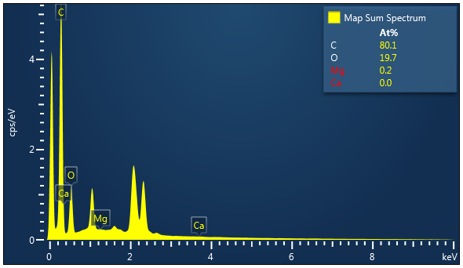
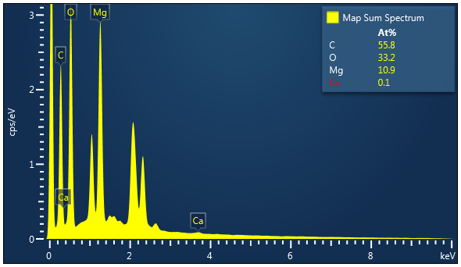
20 ppm Mg 0 ppm Ca
FSWB
Scaling
FB
10 μm
10 μm

Slide 4
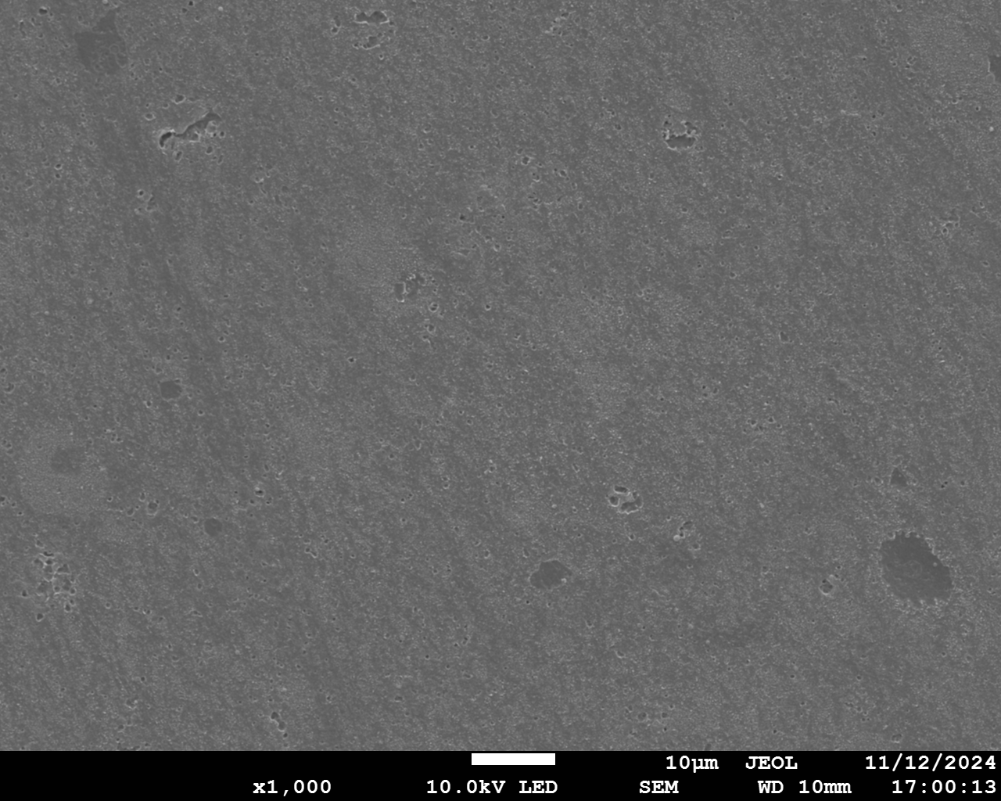
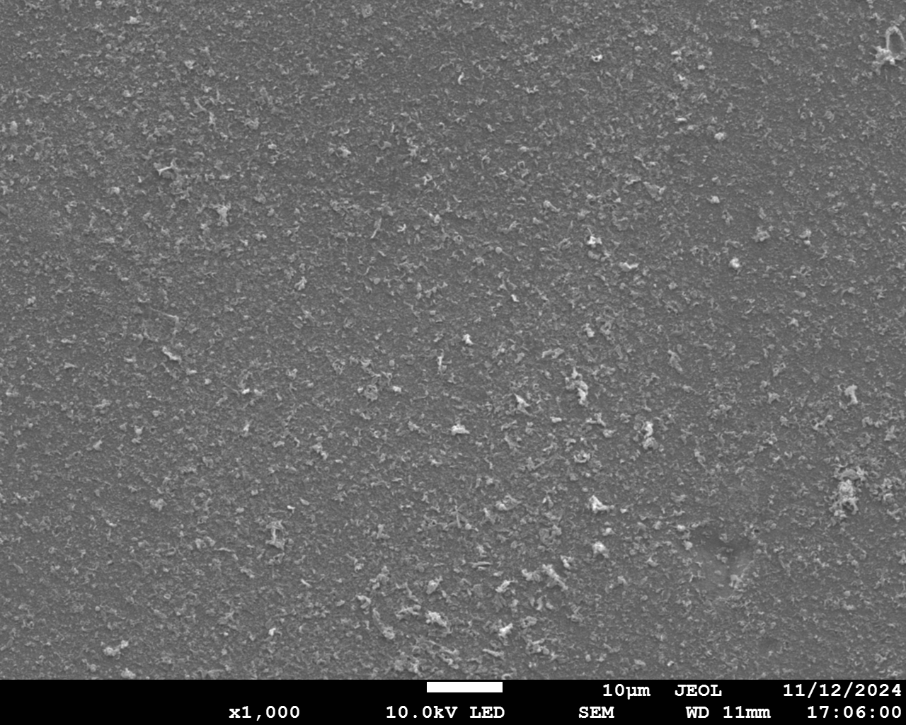


10 ppm Mg 0 ppm Ca
FSWB
Scaling
FB
10 μm
10 μm

Slide 5
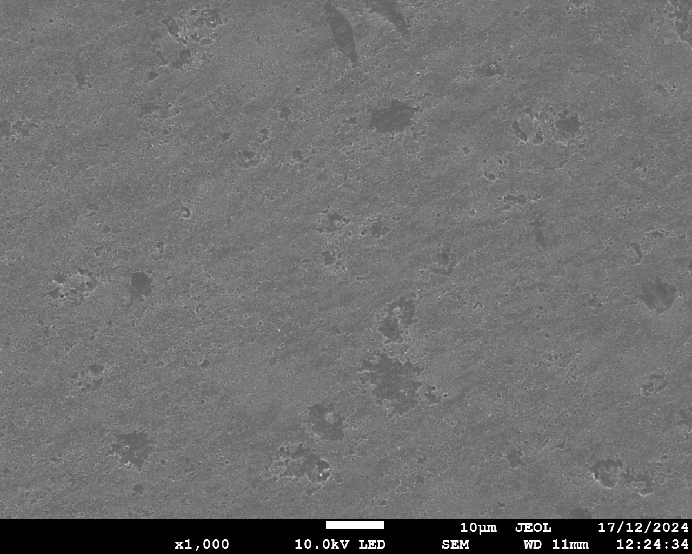
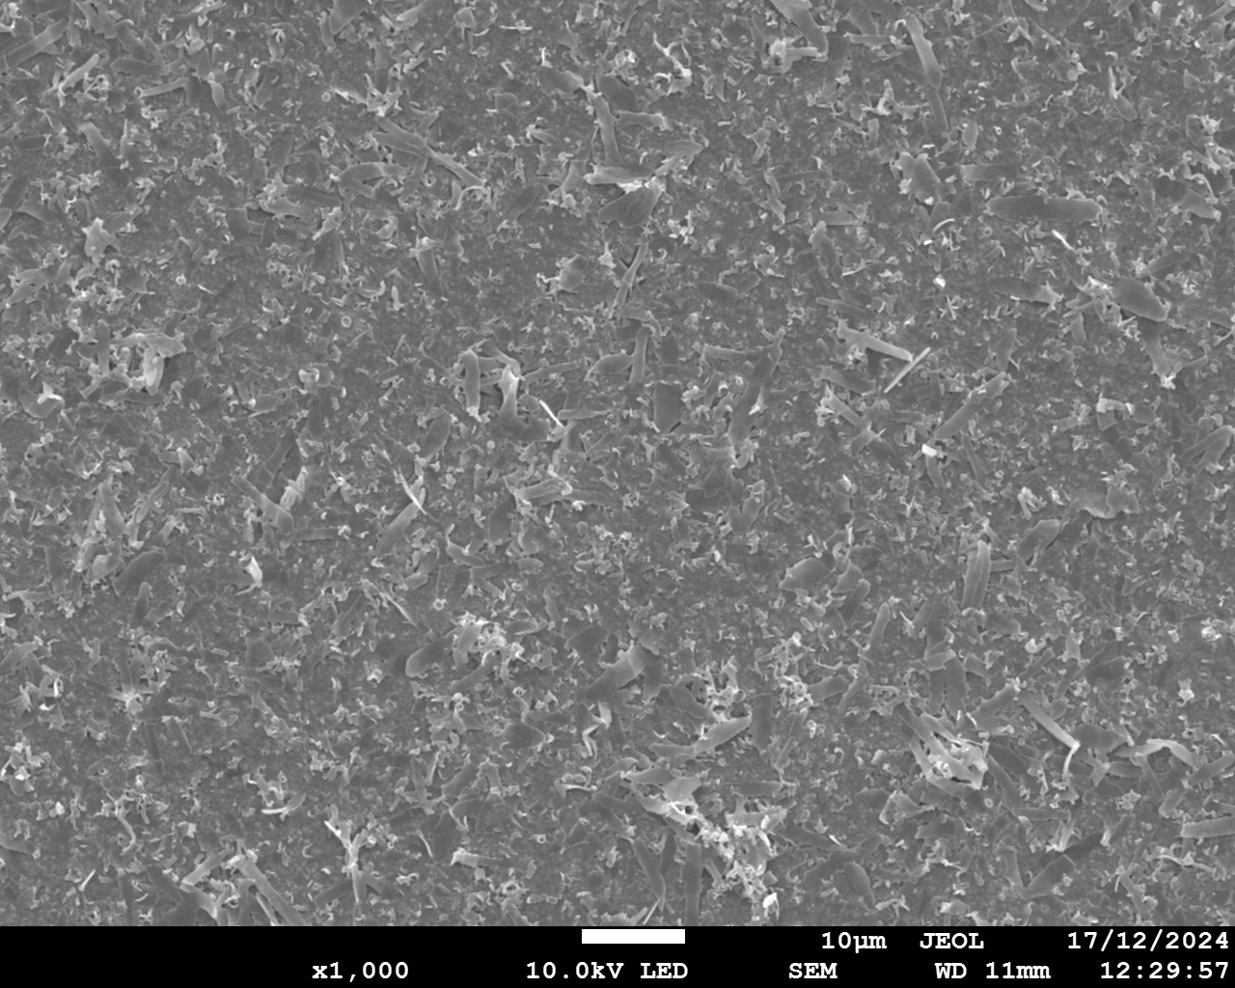
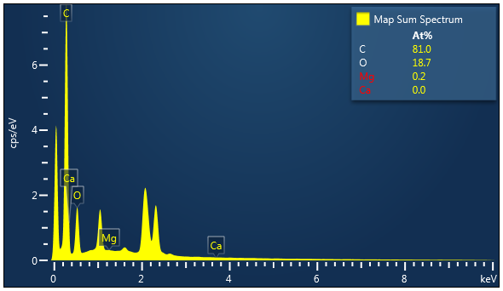
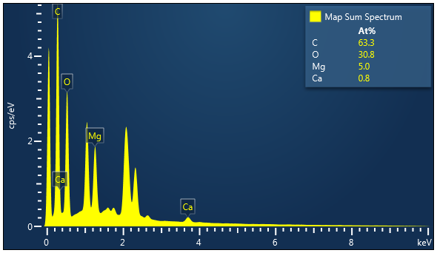
1 ppm Mg 0 ppm Ca
FSWB
Scaling
FB
10 μm
10 μm

Slide 6
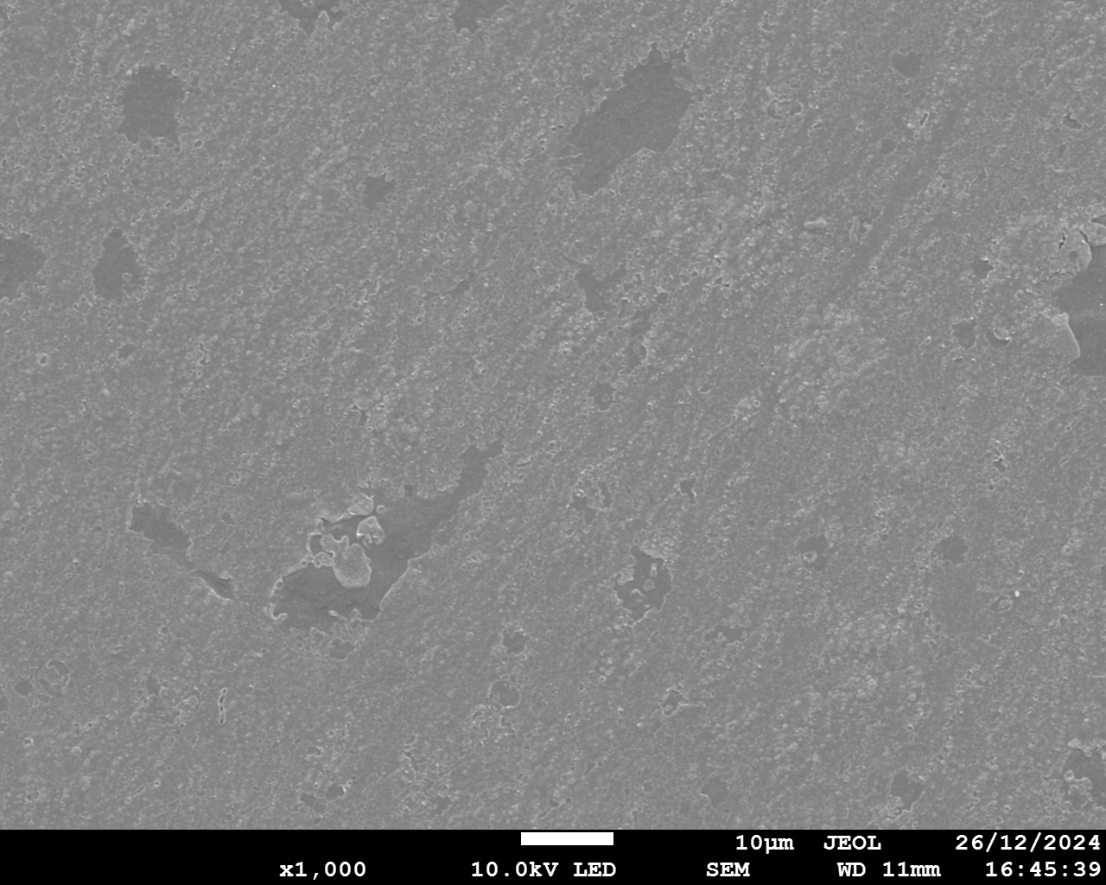
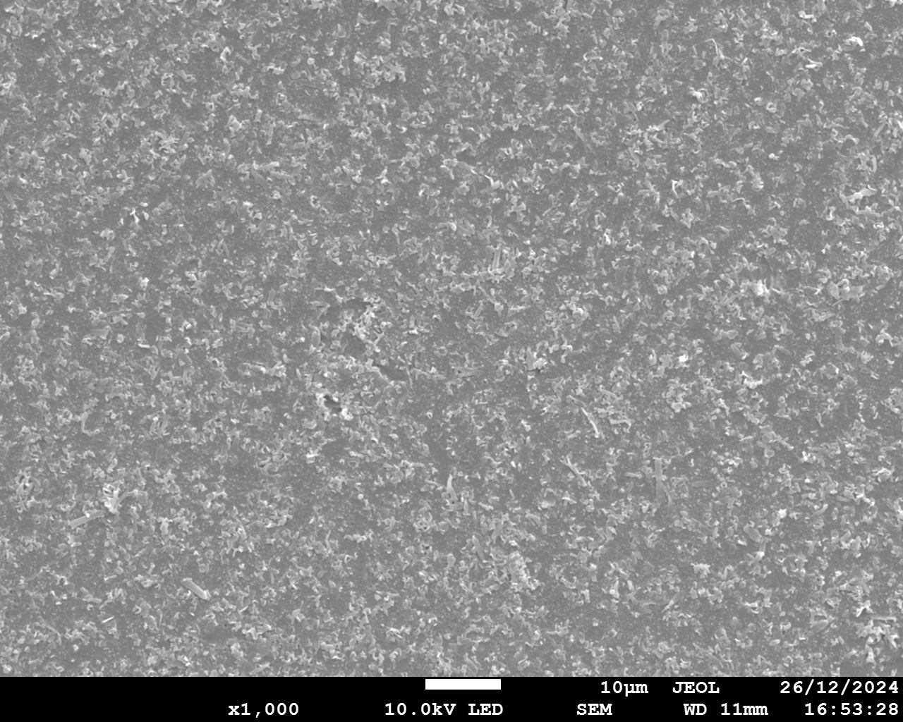
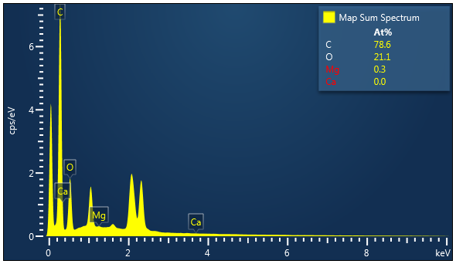
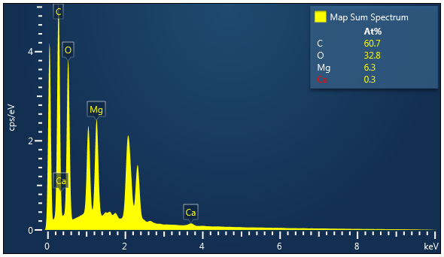
0.1 ppm Mg 0 ppm Ca
FSWB
Scaling
FB
10 μm
10 μm

Slide 8
When [Mg2+] is between 0.1~20 ppm, base concentration is higher. SEM also shows that scaling is generated on surface facing base chamber below 20 ppm.

